Slide 1

BASH
BASICS

Slide 2
SHELL
SCRIPTING

Slide 3

What?
Shell Scripting is making a program to write a series of commands for the shell to execute
Why?
It combines lengthy and repetitive sequences of commands that can be stored and executed anytime which, reduces programming efforts

Slide 4
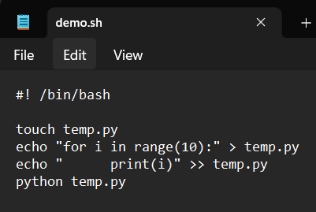
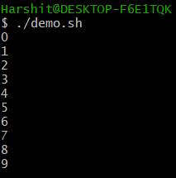
How?
Open your favorite text editor...
Note the extension of file
Run the script in the shell terminal
./filename
Line to be added in the
beginning of every script
Commands to be executed
Commands
executed

Slide 5
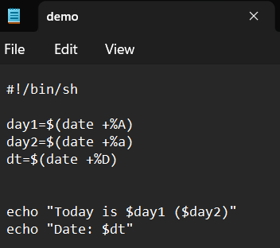
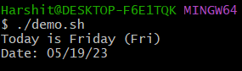
Shell Variables
Declare variables as name=value Note: there must be no space on either side of ‘=’
$ is used to access the value of a variable, expression or a command

Slide 6
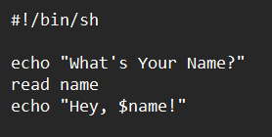

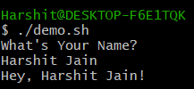
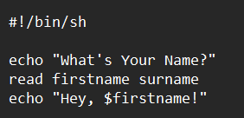

Read Input
The input is split at <space> & <tab> according to no. of variables declared
Take input using command: read variable

Slide 7
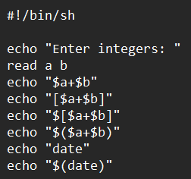
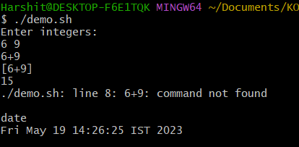
Evaluate Expressions & Commands
To evaluate expressions:
$[expression]
To evaluate commands:
$(command)

Slide 8
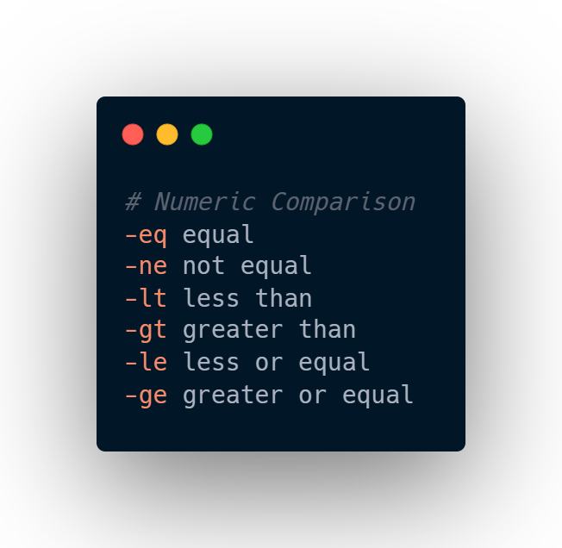
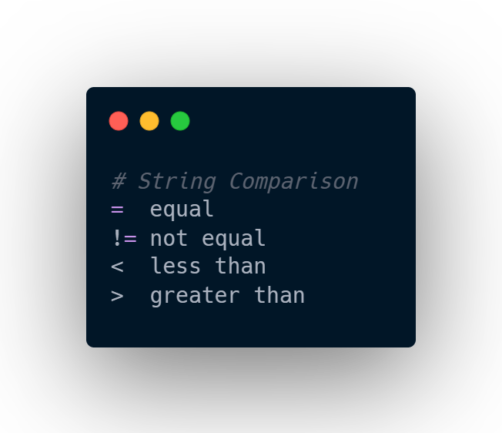
Some Comparison Operators

Slide 9
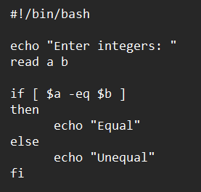
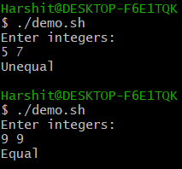
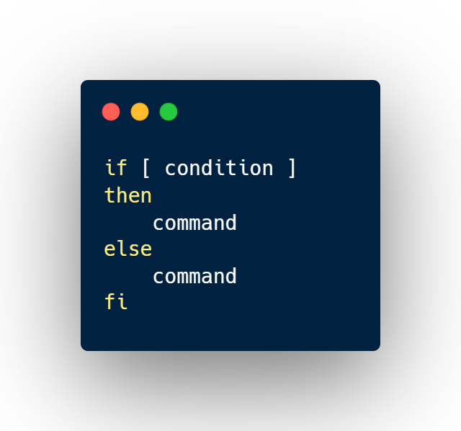
If-Else Statements

Slide 10
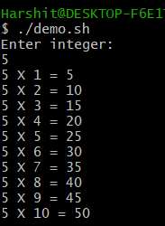
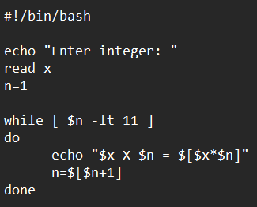
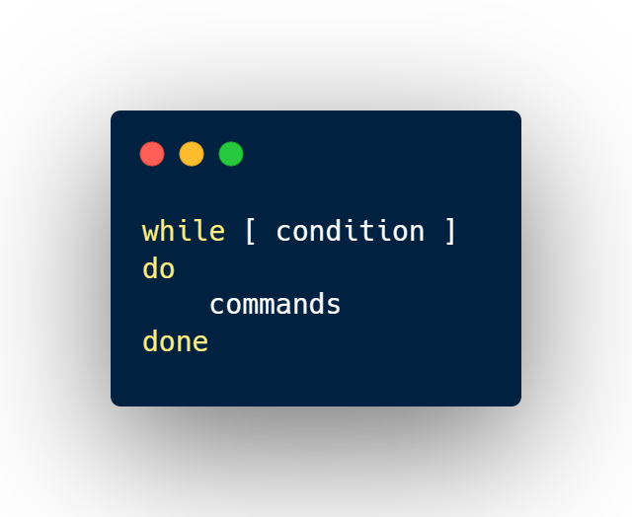
While Loops

Slide 11
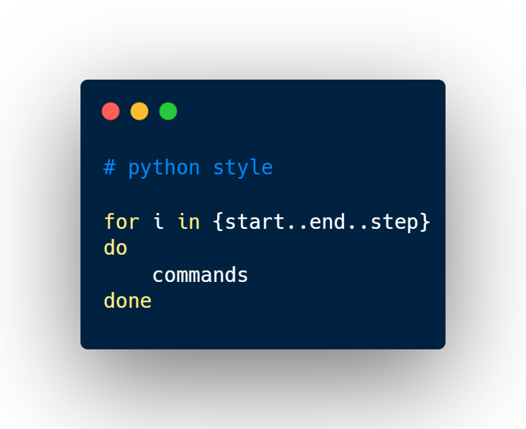
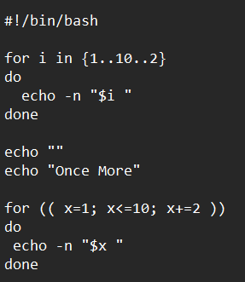

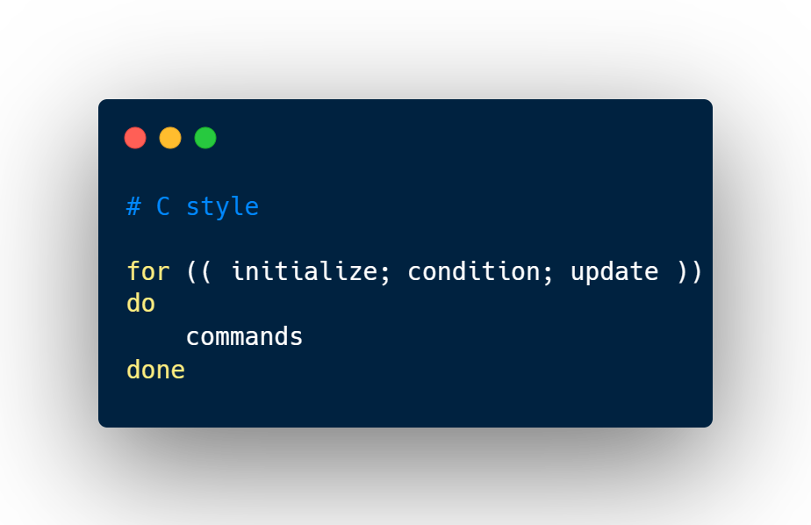
For Loops
flag to print output of next echo in the same line

Slide 12
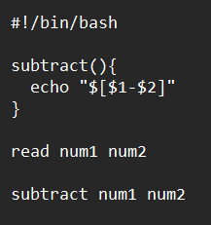
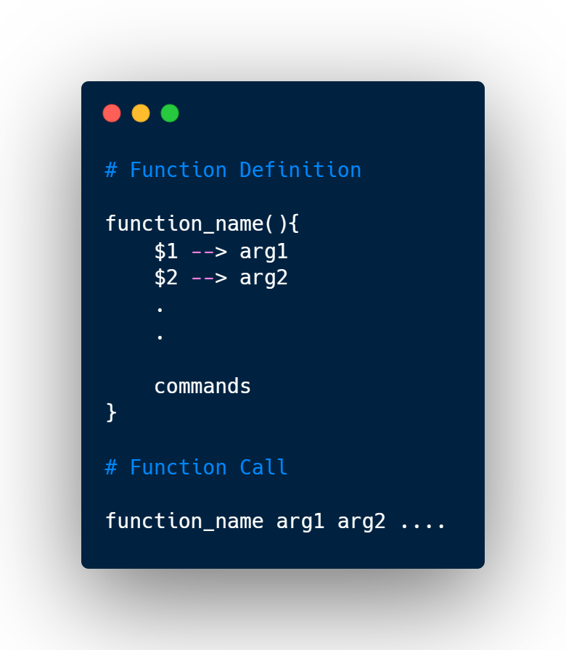
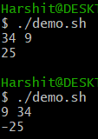
Functions

Slide 13
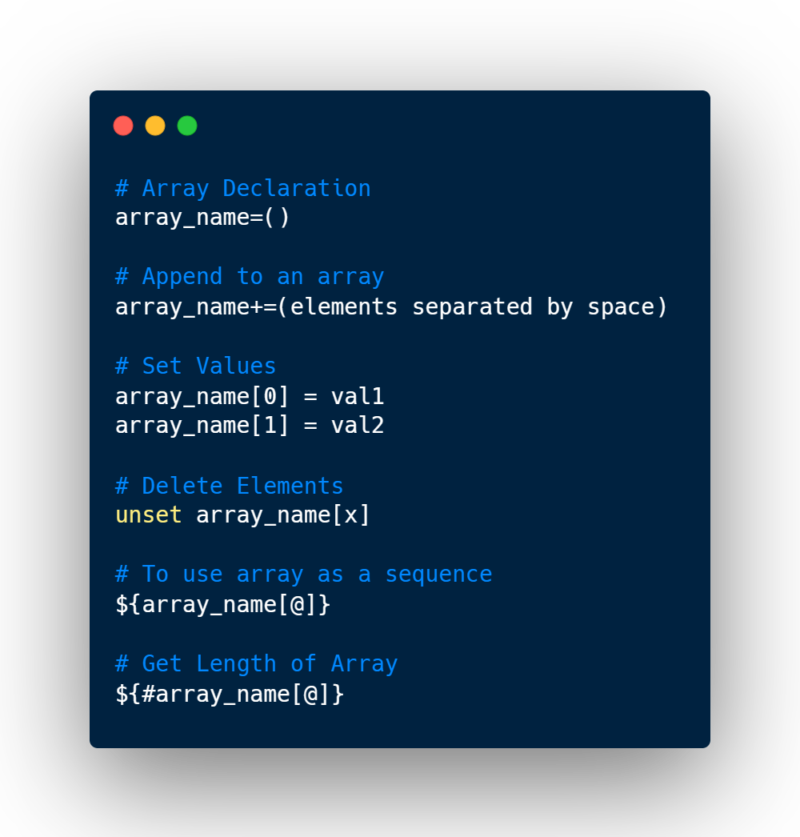
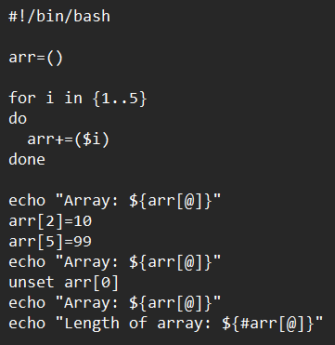
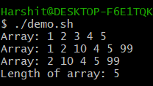
Bash Arrays

Slide 14
Bash Arrays
Moving on to utilize Shell Scripting to read data from CSV files through Bash Terminal...

Slide 15
PARSING
CSV
FILES

Slide 16
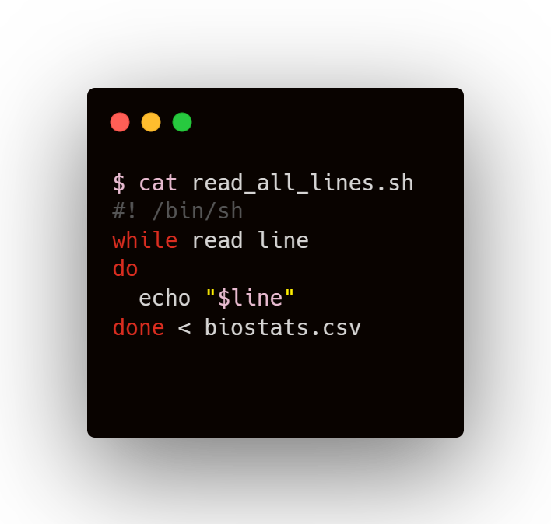
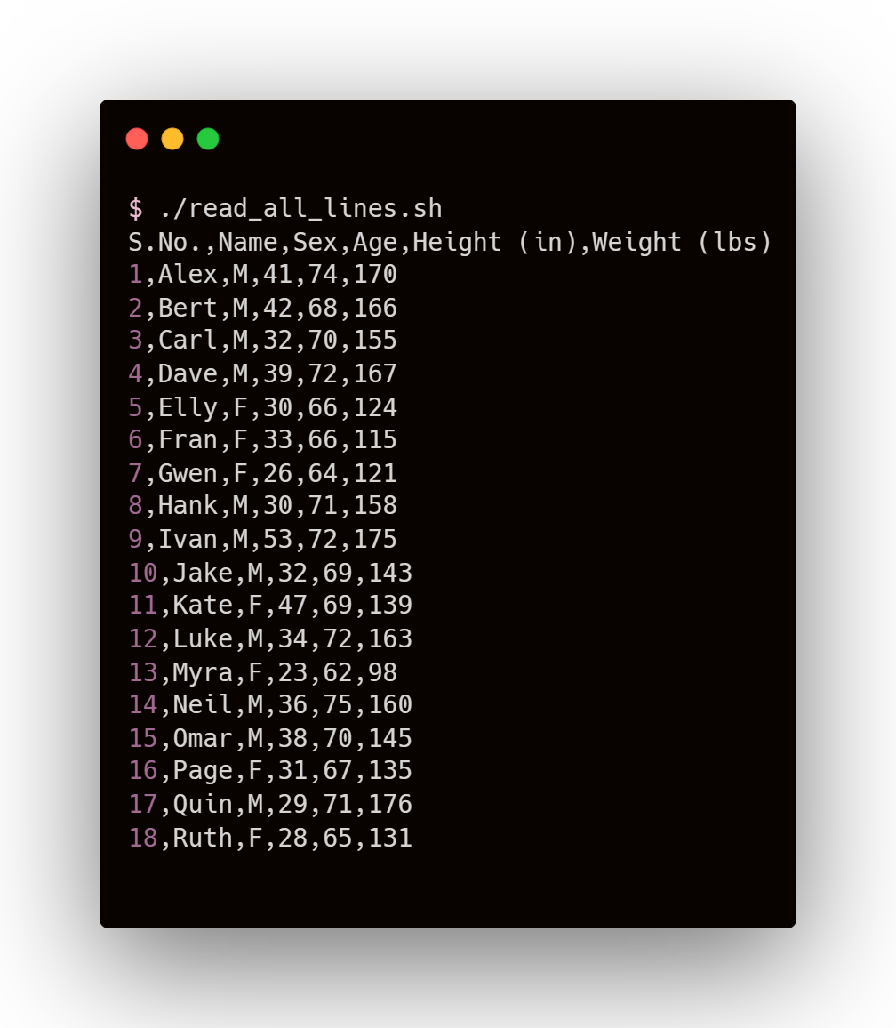
Reading All Lines

Slide 17
Reading All Lines
Input Redirection
Setting the desired file as input for the while-do-done loop

Slide 18
Reading All Lines
Reading from file
A line (ending with newline character) is stored in ‘line’ variable
Input Redirection
Setting the desired file as input for the while-do-done loop

Slide 19
Reading All Lines
COMMANDS
OUTPUT

Slide 20
How to ignore Header?

Slide 21
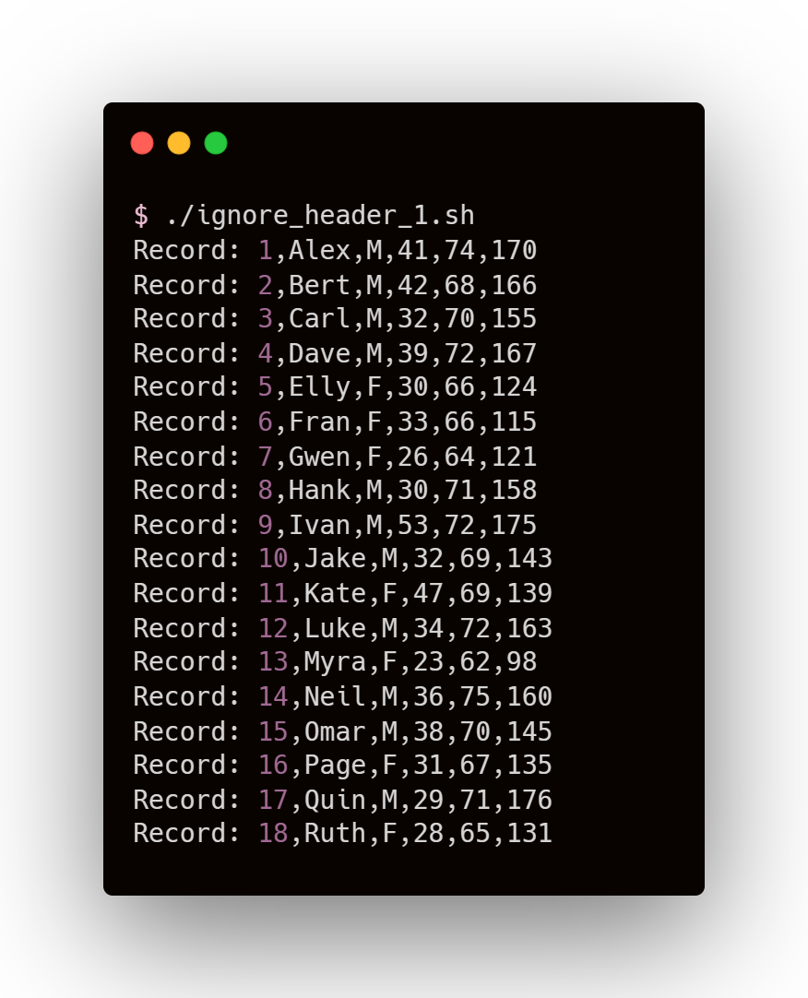
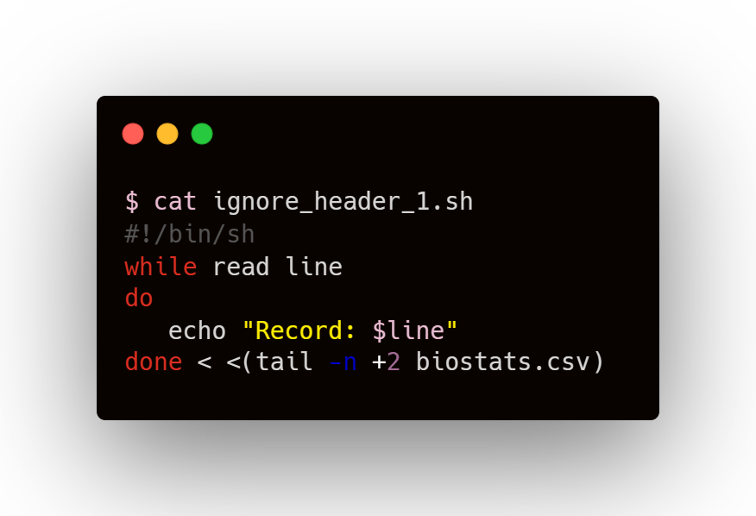
How to ignore Header?

Slide 22
How to ignore Header?
tail Command
tail filename
Returns last 10 lines of file
tail –n x filename
Returns last x lines of file
tail –n +x filename
Returns lines from xth line to end

Slide 23
How to ignore Header?
tail Command
tail filename
Returns last 10 lines of file
tail –n x filename
Returns last x lines of file
tail –n +x filename
Returns lines from xth line to end
Process Substitution
<(command) allows the command to appear as a file

Slide 24
How to ignore Header?
tail Command
tail filename
Returns last 10 lines of file
tail –n x filename
Returns last x lines of file
tail –n +x filename
Returns lines from xth line to end
No Space for process substitution
Space for redirection
Process Substitution
<(command) allows the command to appear as a file

Slide 25
How to ignore Header?
COMMANDS
OUTPUT

Slide 26
How to ignore Header?
Since we can skip reading header (the first row of file), there must be a similar way to read specific rows of the data...

Slide 27
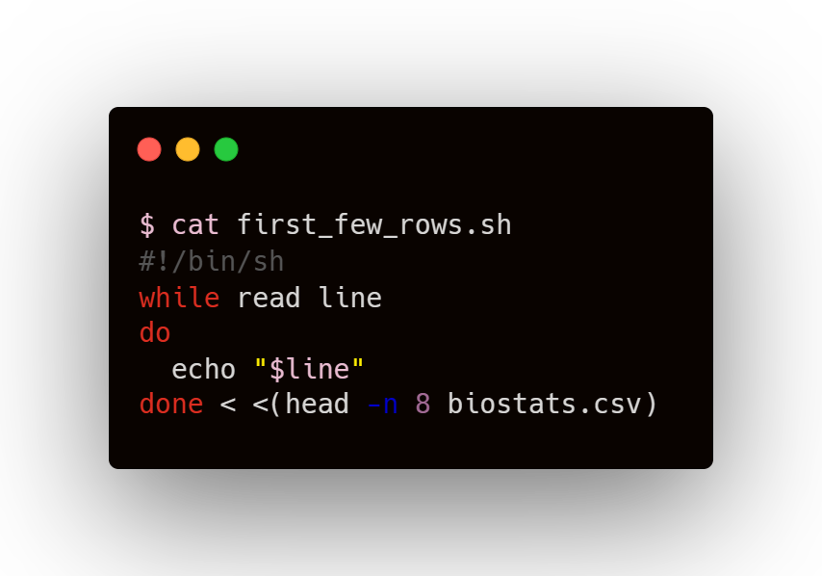
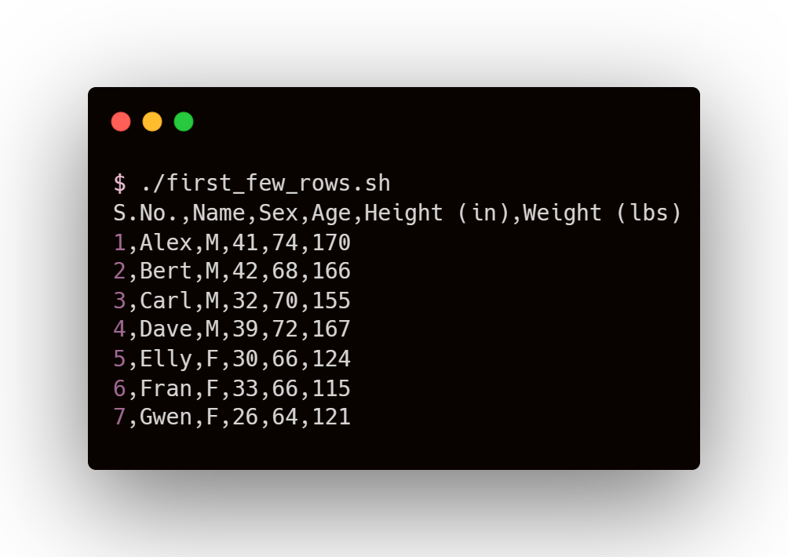
Read first few rows

Slide 28
Read first few rows
head Command
head filename
Returns first 10 lines of file
head –n x filename
Returns first x lines of file

Slide 29
Read first few rows
COMMANDS
OUTPUT

Slide 30
Read first few rows
We can use head command along with tail command to read rows in a specific range

Slide 31
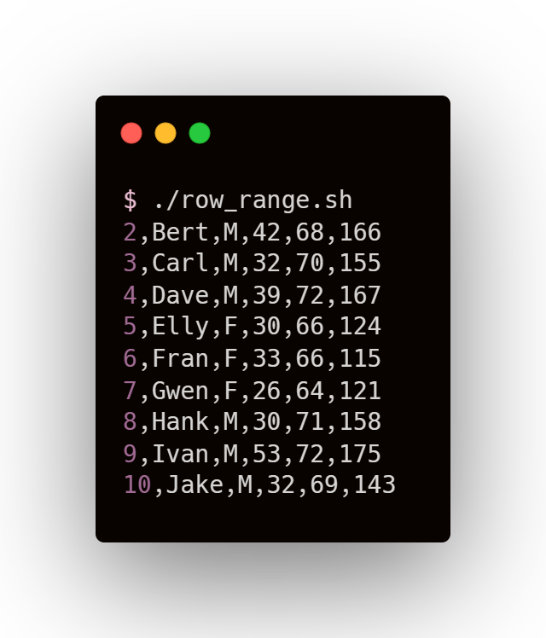
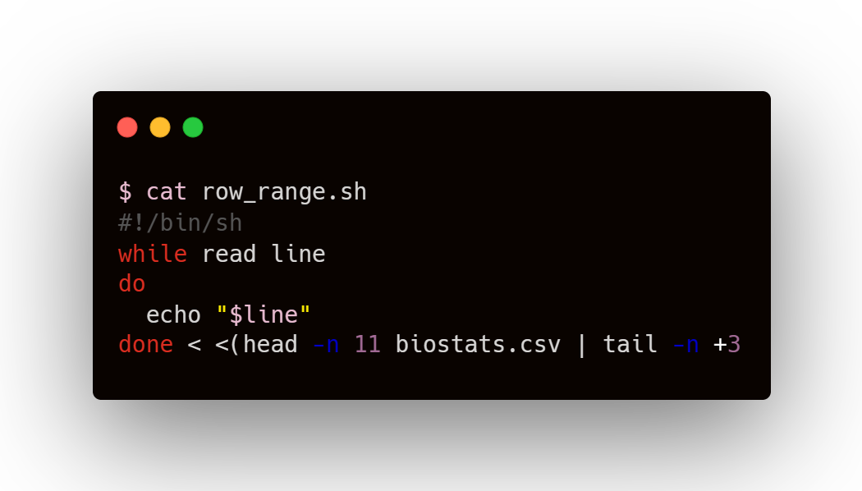
Read rows in a specific range

Slide 32
Read rows in a specific range
Piping
Output of first application (left of pipe ‘|’) becomes the input of second application (right of pipe)

Slide 33
Read rows in a specific range
Piping
Output of first application (left of pipe ‘|’) becomes the input of second application (right of pipe)
File
First x lines of file
yth to xth lines of file
head –n x
tail –n +y

Slide 34
Read rows in a specific range
COMMANDS
OUTPUT

Slide 35
Read rows in a specific range
To read columns, we make use of the fact that CSV files contain Comma Separated Values

Slide 36
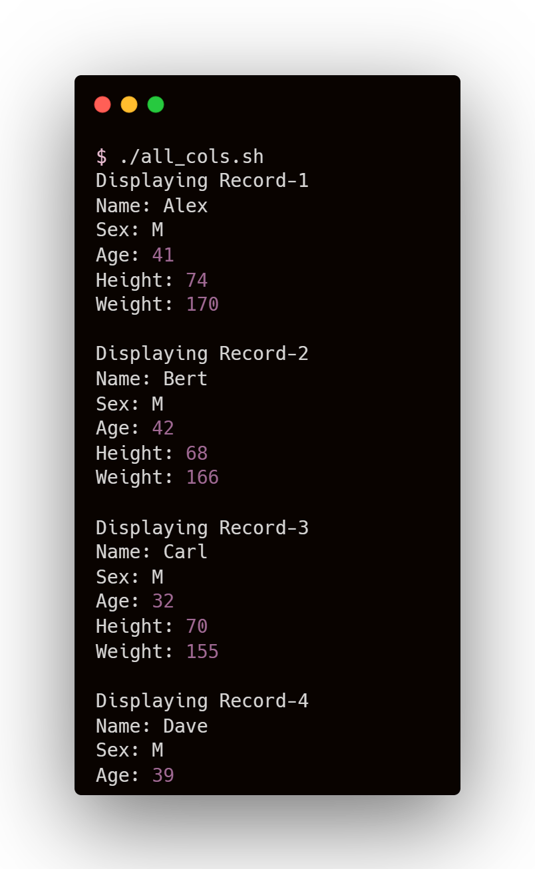
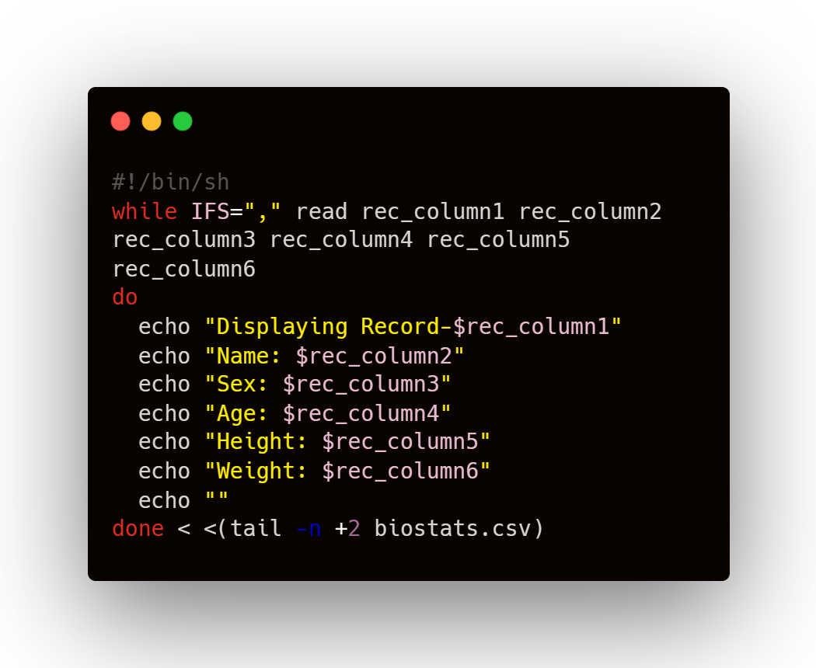
Read all columns

Slide 37
Read all columns
Internal Field Separator
Using IFS, line is divided into fields (tokens) and each token is assigned to a separate variable
For CSV, setting IFS=‘,’ is an obvious choice. For a line, each token is value from different column

Slide 38
Read all columns
COMMANDS
OUTPUT

Slide 39
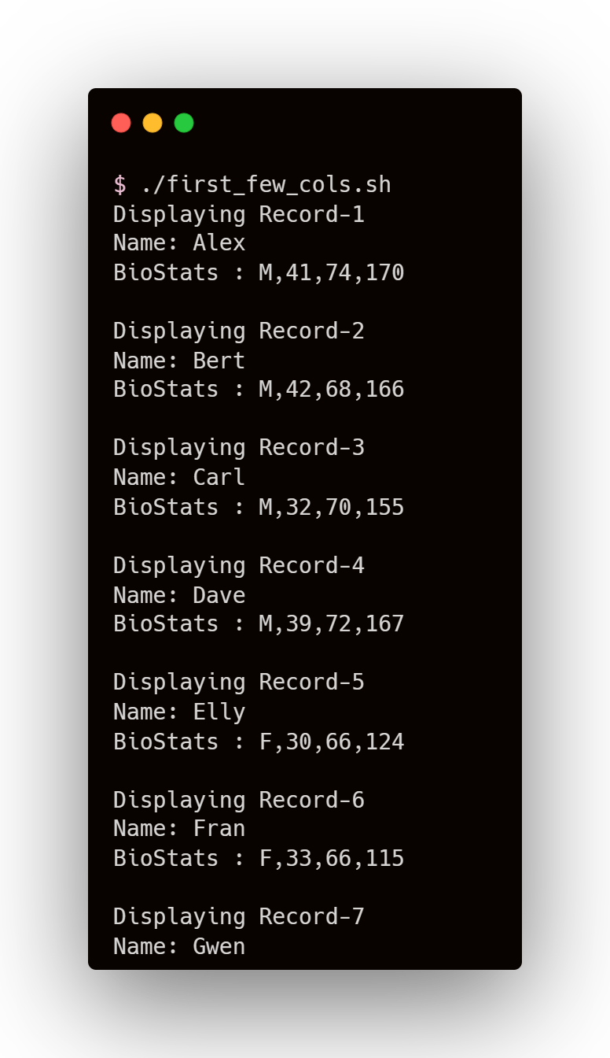
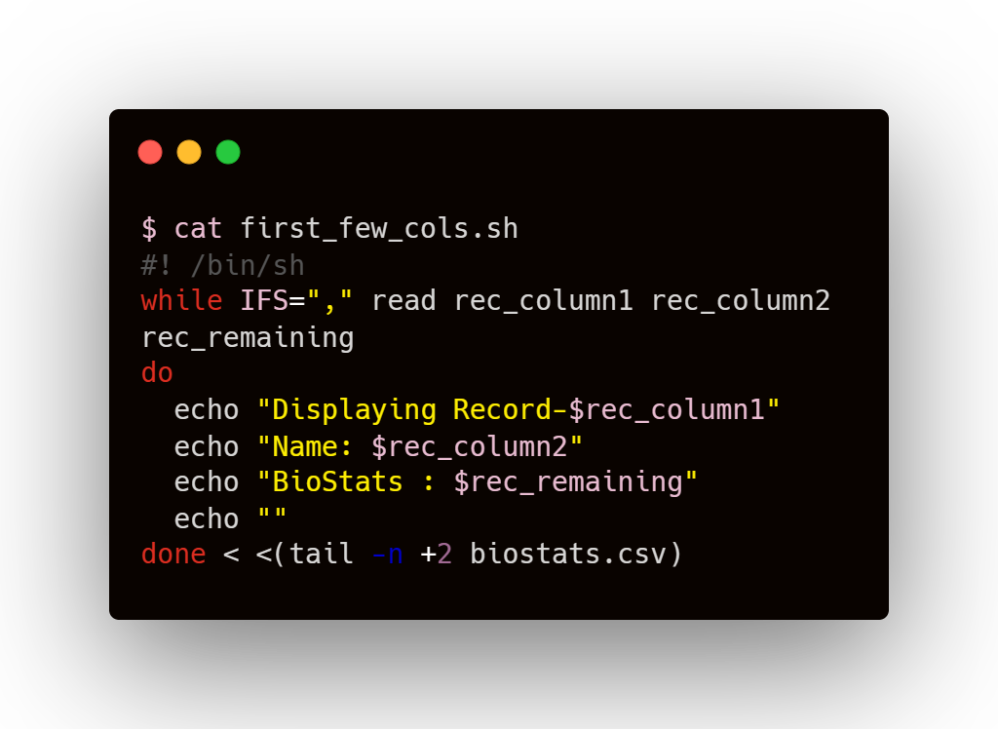
Read first few columns

Slide 40
Read first few columns
As number of variables defined is less than the number of columns, all remaining fields are assigned to the last variable
In fact, if there are (x) variables, the line is split (x-1) times, giving (x) tokens

Slide 41
Read first few columns
COMMANDS
OUTPUT

Slide 42
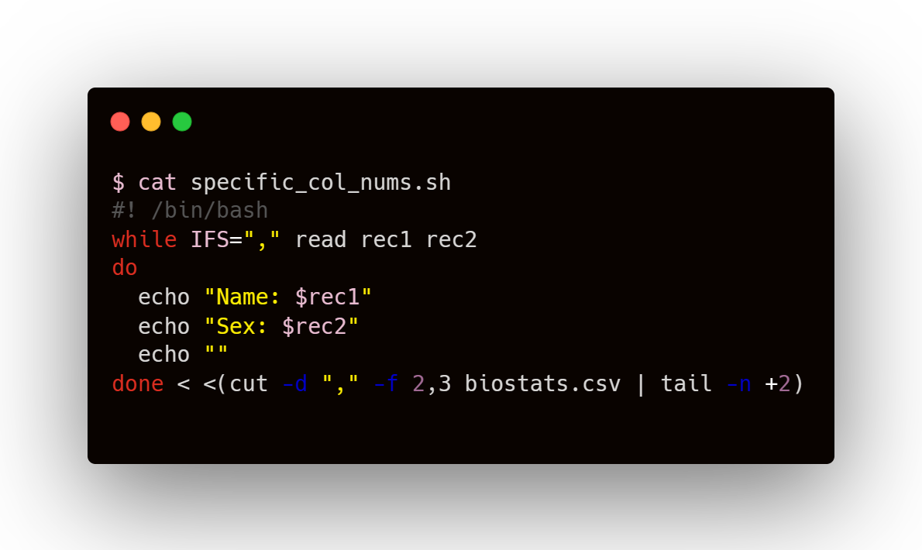
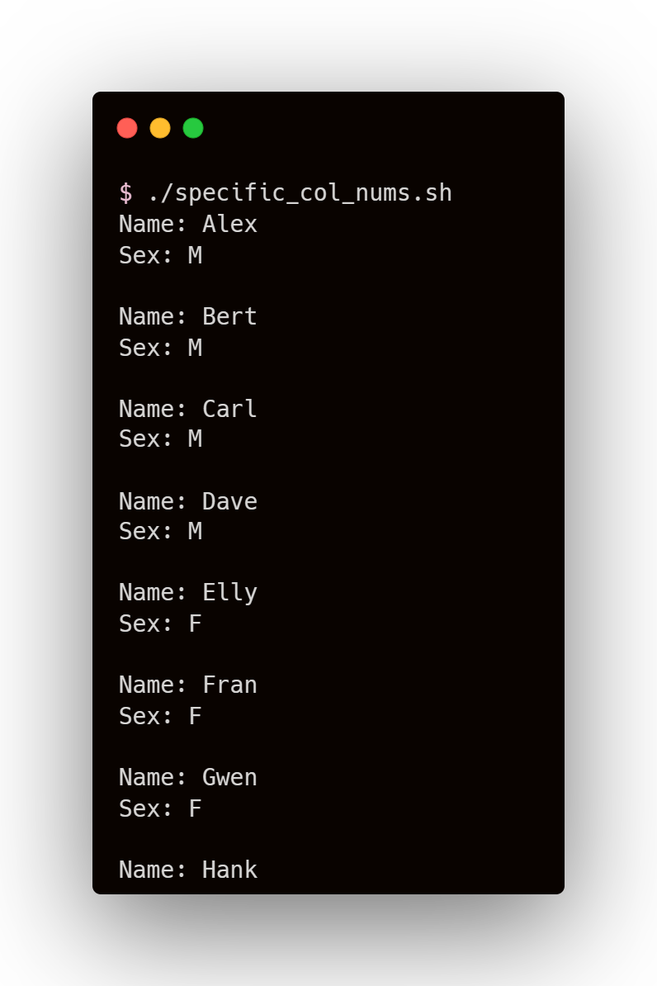
Read by specific column numbers

Slide 43
Read by specific column numbers
Cut command
for cutting sections from each line of file
column no’s
setting delimiter (character at which cutting is desired)
To slice data field by field

Slide 44
Read by specific column numbers
COMMANDS
OUTPUT

Slide 45
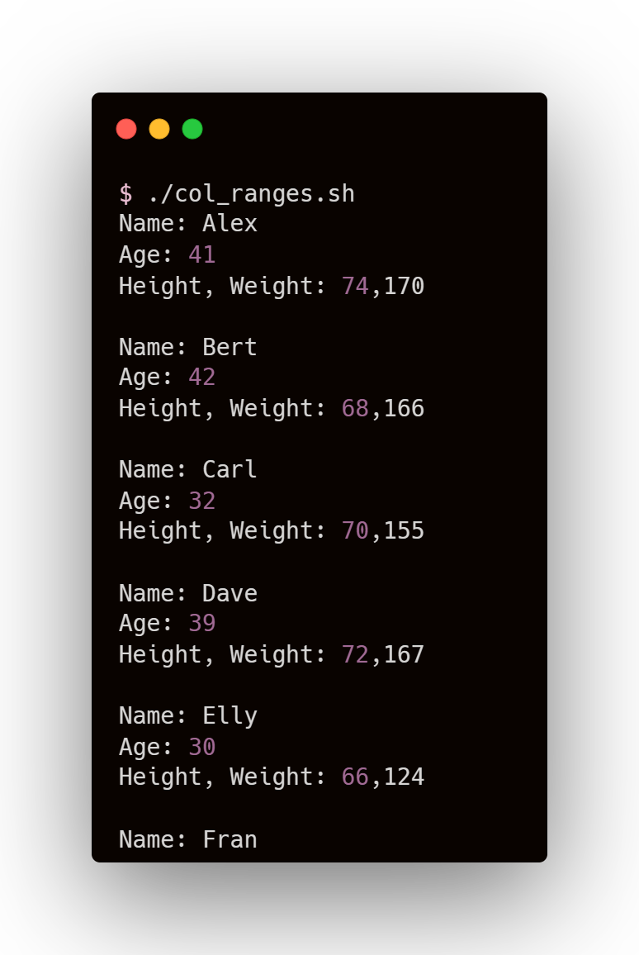
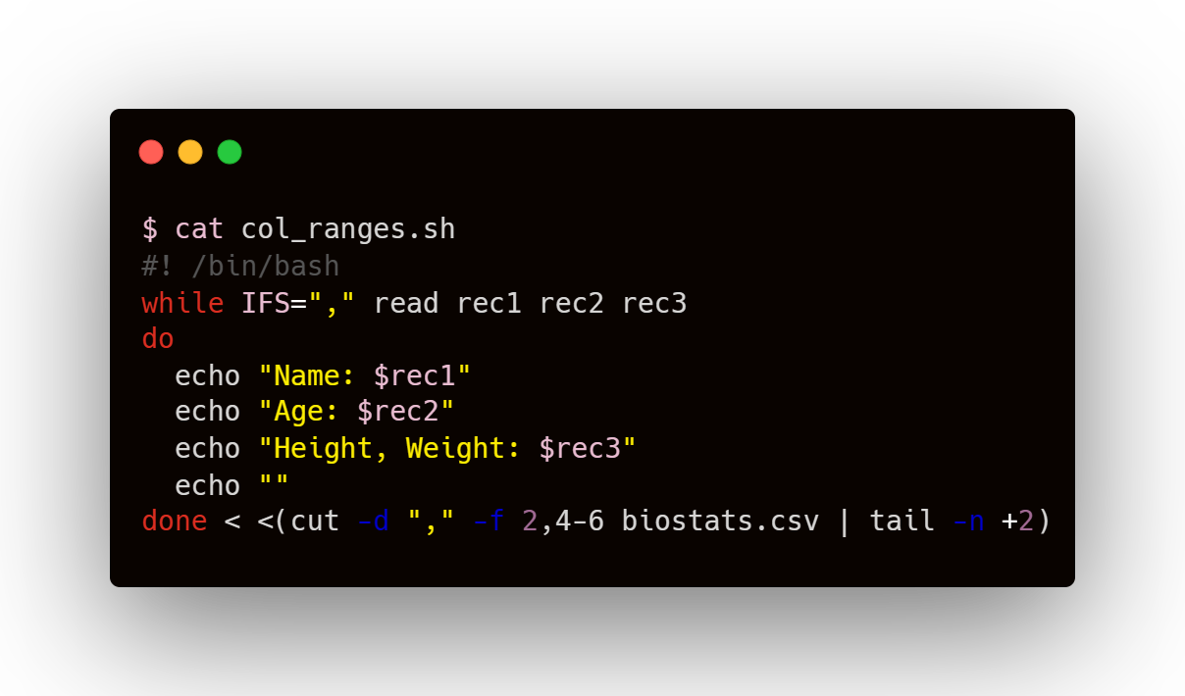
Read columns in a range

Slide 46
Read columns in a range
column numbers and column ranges separated by comma

Slide 47
Read columns in a range
Col 2
Col 4
Col 5
Col 6
rec1 rec2 rec3
column numbers and column ranges separated by comma

Slide 48
Read columns in a range
COMMANDS
OUTPUT

Slide 49
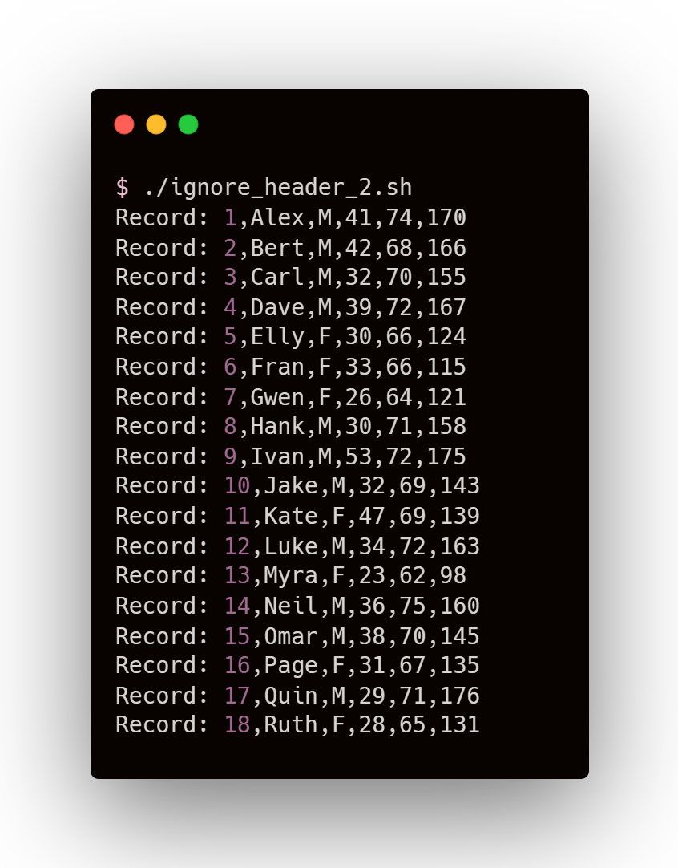
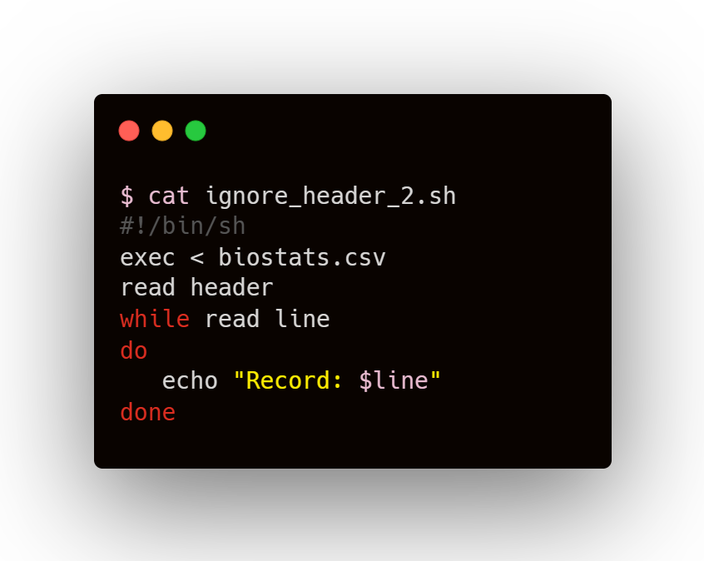
Another method
to ignore Header

Slide 50
Another method
to ignore Header
exec Command
Here, it changes stdin to the specified file

Slide 51
Another method
to ignore Header
exec Command
Here, it changes stdin to the specified file
Reading header, storing it in “header” variable and then not echoing it

Slide 52
Another method
to ignore Header
exec Command
Here, it changes stdin to the specified file
Reading header, storing it in “header” variable and then not echoing it
No need of input redirection here as stdin was already changed to file

Slide 53
Another method
to ignore Header
COMMANDS
OUTPUT

